Slide 1

Docker Image Cleanup Lifecycle in JFrog Artifactory
Streamlining the lifecycle management of Docker images stored in JFrog Artifactory. This presentation outlines our automated process for identifying, scanning, and safely removing unused images.
by CodeZero Zero

Slide 2
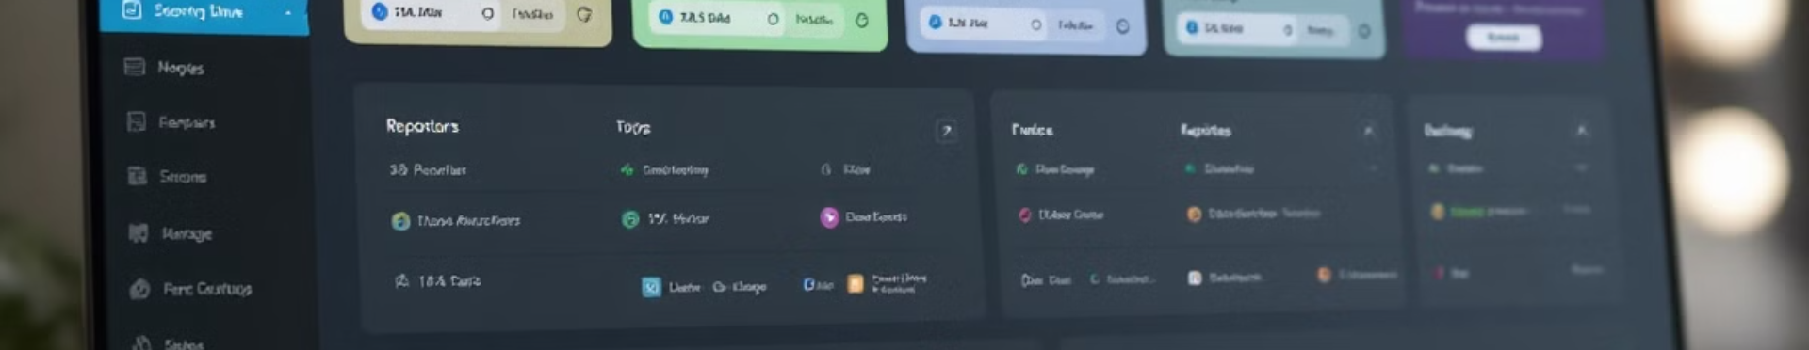
Overview of JFrog Artifactory as Docker Registry
1
Centralized Repository
2
Comprehensive Storage
3
Advanced Management
JFrog Artifactory serves as a single source of truth for all Docker images across our organization.
The registry maintains both active and unused application images with complete version history.
JFrog provides robust APIs and tools for image tagging, versioning, and access control.

Slide 3
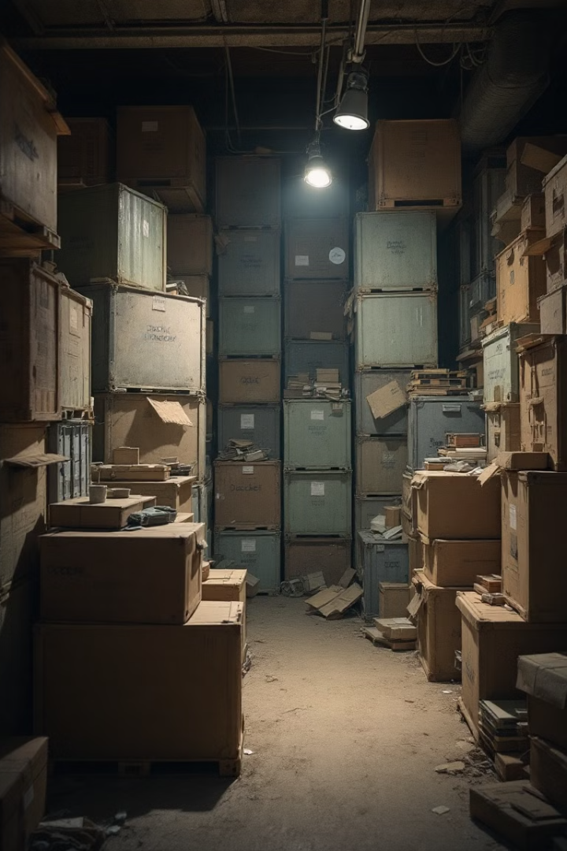




Challenges of Unused Docker Images
Storage Costs
Security Risks
Registry Clutter
Unused images consume valuable storage space, increasing infrastructure expenses unnecessarily.
Outdated images often contain unpatched vulnerabilities that pose organizational security threats.
Image proliferation makes finding and managing current artifacts difficult for development teams.
Performance Impact
Bloated registries slow down CI/CD pipelines when pulling or pushing images.

Slide 4





Automated Cleanup Process
Apply Criteria
Scan Registry
2
Filter by age, tags, and usage metrics
1
Regularly scan for unused images
Detect Vulnerabilities
3
Scan for CVEs in identified images
5
Delete Approved Images
Remove confirmed images from registry
Notify Stakeholders
4
Send email reports for approval
Our automation runs weekly to maintain optimal registry health without manual intervention.

Slide 5

CVE Scanning and Risk Assessment
Report Generation
Risk Scoring
Detailed reports document all findings with impact analysis and remediation suggestions.
Automated Scanning
Vulnerabilities receive CVSS scores to prioritize high-risk images for immediate action.
Integration Setup
Each image undergoes thorough scanning against NIST and vendor-specific CVE databases.
JFrog Xray connects directly to Artifactory for seamless vulnerability scanning of all Docker images.

Slide 6
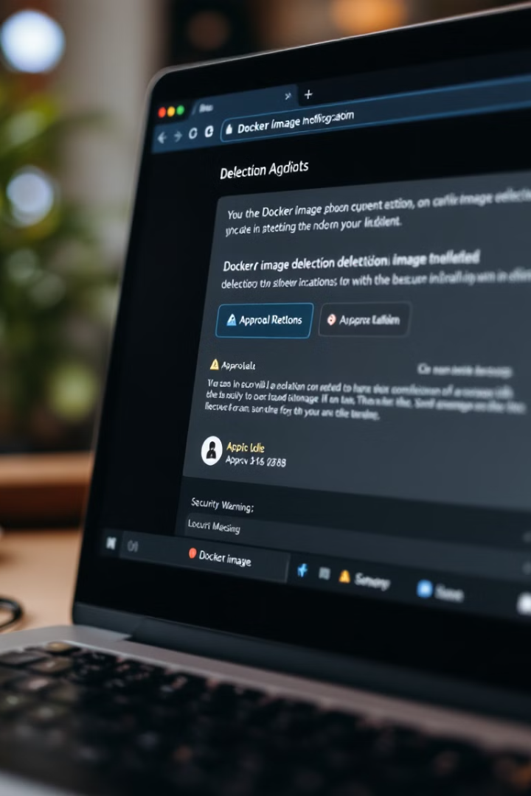




Email Notification and Confirmation Workflow
Generate Alert
System creates detailed notifications for each batch of images flagged for removal.
Send Email
Stakeholders receive reports listing images, age, CVEs, and potential impact of removal.
Collect Response
Recipients review and submit approval or denial through a secure confirmation link.
Track Decisions
System logs all responses and prepares approved images for the deletion process.

Slide 7

Secure Deletion Process
1
Verification
System cross-checks deletion approvals against required authorization levels before proceeding.
2
Removal
JFrog API calls systematically delete each approved image and its associated layers.
3
Metadata Cleanup
All tags, references, and indexed data for removed images are purged from the registry.
4
Audit Logging
Each deletion action is logged with timestamp, approver, and complete image details.

Slide 8
Benefits and Best Practices
Cost Reduction
Security Enhancement
Operational Efficiency
Organizations typically see 30-50% reduction in storage costs after implementing automated cleanup.
Regular removal of vulnerable images significantly reduces the attack surface and compliance risks.
Cleaner registries improve developer productivity and CI/CD pipeline performance.
Implement image tagging conventions. Set clear retention policies. Consider environment-specific rules. Document exceptions for compliance or legacy systems.

